Slide 1

Case Study II:
A Web Server
Based on the book:
Performance by Design – Computer Capacity Planning by Example
(D. Menascé, V. Almeida, L. Dowdy)

Slide 2
Introduction
Concepts of performance engineering
  Determination of confidence intervals
  Computation of service demands from results of experiments
  The usage of linear regression
  Comparison of alternatives
    Through analytic modelling
    Through experimentation
Examples will be supported by Excel spreadsheets

Slide 3
The Web Server
Consider a software company uses an internal Web server to allow its personnel to download two types of files:
  PDF files containing documents and manuals
  ZIP files containing software files
Server has one CPU
Server has four identical disks
  PDF files are stored on disk 1 and 2
  ZIP files are stores on disk 3 and 4
The load on two disks is balanced

Slide 4
The main questions of interest:
What is the maximum number of concurrent PDF and ZIP file downloads that can be in progress in order to satisfy a certain prespecified SLA?
What is the impact of using Secure Socket Layer (SSL) for secure downloads?

Slide 5
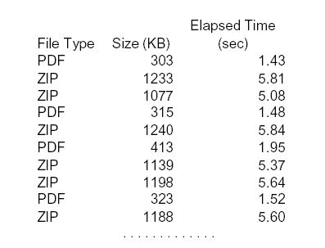

Preliminary Analysis of the Workload
The web log contains 1000 entries for file downloads captured over 200s
Times may be captured with Microsoft Internet Information Server (IIS)
Sample of
„WSData.xls“ :

Slide 6
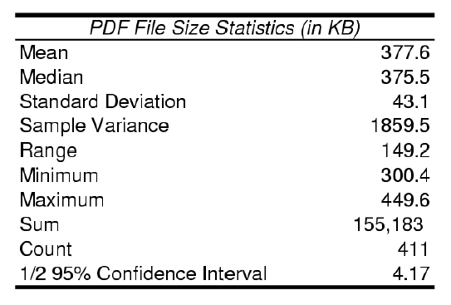
Analysis of the workload:
PDF File Statistics
From an unsorted list of logs statistics have to be collected:

Slide 7
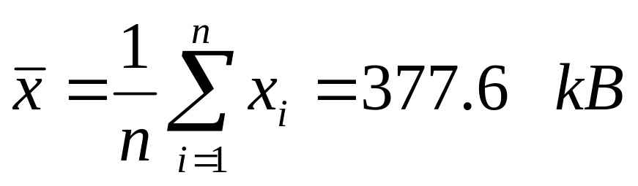
Analysis of the workload:
PDF File Statistics, Mean
Given:
# of PDF log entries: n = 411
Total sum of file size: 155183 kB
Computation of the arithmetric mean

Slide 8
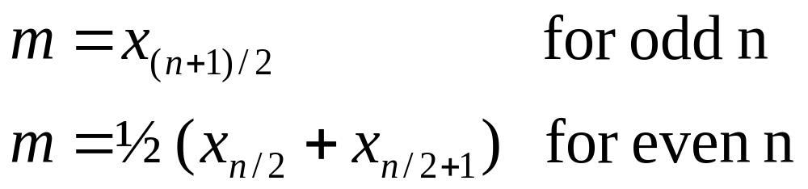
Analysis of the workload:
PDF File Statistics, Median
Given:
# of PDF log entries: n = 411
x_{i} entries from sorted log
Computation of the median
m = x₂₀₆ = 375.5 kB

Slide 9

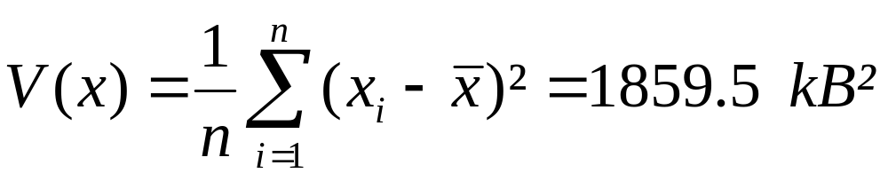
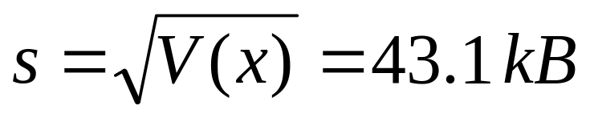
Analysis of the workload:
Sample Variance & Standard Deviation
Given:
# of PDF log entries: n = 411
Mean = 377.6 kB
Computation of Sample Variance
Computation of Standard Deviation

Slide 10
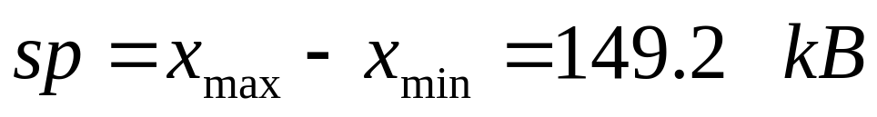
Analysis of the workload:
PDF File Statistics, Range
Very easy to calculate
Given:
Minimum x_{min} = 300,4 kB
Maximum x_{max} = 449,6 kB
Computation of the Range

Slide 11
Analysis of the workload:
PDF File Statistics, Coefficient of Variation
# of PDF log entries: n = 411
Average size of a file: = 377.6 kB
Standard derivation: s = 43.1 kB
C_{PDF} = 43.1 kB / 377.6 kB = 0.114
Computation of the Coefficient of Variation
For values < 0.25 it is safe to assume the data set forms a single class
C_{PDF} meets this requirement

Slide 12
Analysis of the workload:
PDF File Statistics, Confidence Interval
½ 95% Confidence Interval c = 4.17 kB
kB
377.6-4.17
377.6
377.6+4.17
What is the meaning of this number?
The sample average is known from 411 sampled files
The actual average is unknown, since the true underlying distribution is also unknown.
So this number indicates that one can say with a probability of 0.95 that the actual average is within 4.17 kB of the sampled average of 377.6 kB.

Slide 13

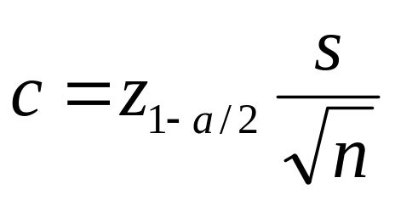
Analysis of the workload:
PDF File Statistics, Confidence Interval
c can be computed using Excel‘s KONFIDENZ function: c = KONFIDENZ (α ; s ; n) with:
  Confidence Coefficient α = 0.05 [1- α = 0.95]
  Sample Standard Deviation s = 43.1 kB
  Sample Size n = 411
Computation of the Confidence Interval

Slide 14
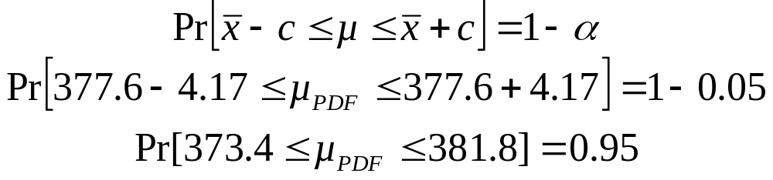
Analysis of the workload:
PDF File Statistics, Confidence Interval
c is the half width of the Confidence Interval, µ the expected value of the underlying distribution and
the sample mean
Computation of the Confidence Interval

Slide 15
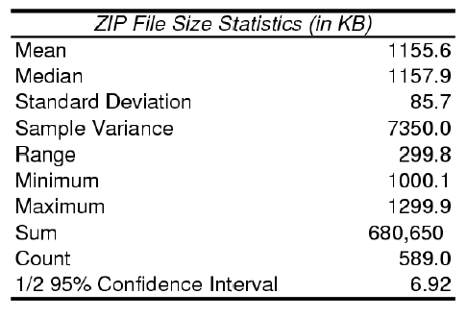
Analysis of the workload:
PDF & ZIP File Statistics
C_{PDF} = 43.1 / 377.6 = 0.114 C_{ZIP} = 85.7 / 1155.6 = 0.074
Comparison of the Coefficient of Variation

Slide 16
Building a Performance Model
Recall the main question:
  What is the maximum number of PDF and ZIP files that can concurrently be downloaded while satisfying a given SLA?
A closed multiclass QN model is used to answer this question
Let‘s complete the parameterisation of the model...

Slide 17
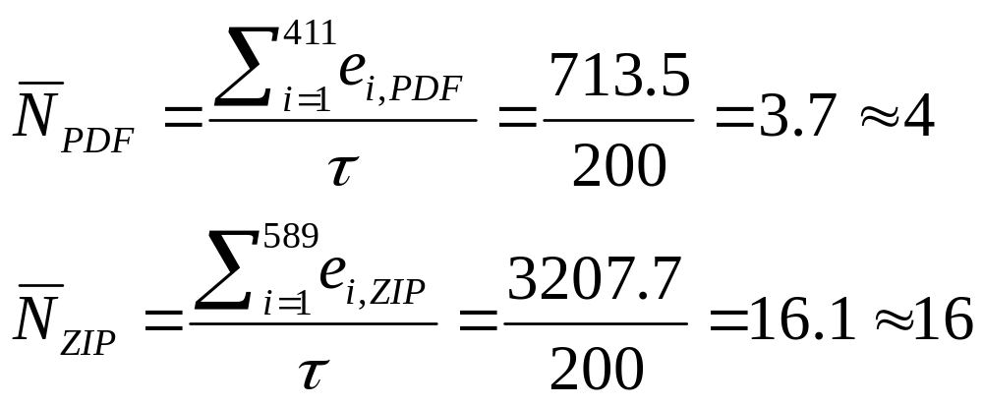
Building a Performance Model:
Computing Concurrency Levels
The log data (in WSData.xls) is used to estimate the mix of concurrent PDF and ZIP downloads
Computation of the Concurrency Levels
Where e_{i,PDF} and e_{i,ZIP} are the elapsed times of PDF and ZIP file downloads in WSData.xls

Slide 18

Building a Performance Model:
Computing Service Demands
Service Demands at the CPU and disk have to be computed for each customer class
Service Demands are a function of file size
To estimate these demands a test server consisting of a single CPU and one disk is sufficient

Slide 19
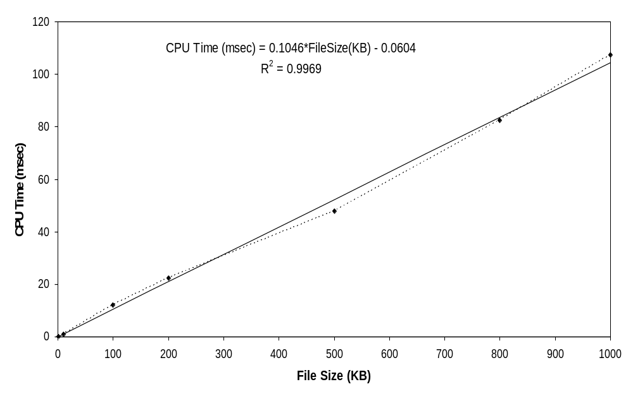
Building a Performance Model:
Computing Service Demands
Experimental data points are connected by a dotted line
A linear trend line is added by using Excel‘s functions

Slide 20
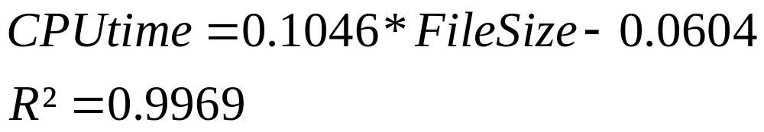
Building a Performance Model:
Computing Service Demands
Computed values for CPU
The R² value represents the Coefficient of Determination and is calculated by Excel
The closer to one, the better the trend line fits the experimental data
R² > 0.95 indicates adequate accuracy

Slide 21
Building a Performance Model:
Computing Service Demands
The average PDF file size is 377.6 kB, so the Service Demand at the CPU for this class is:
Computation of Service Demand

Slide 22
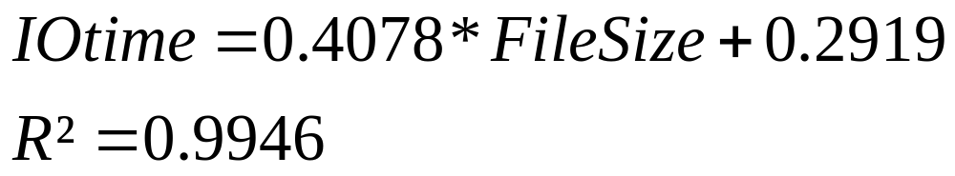
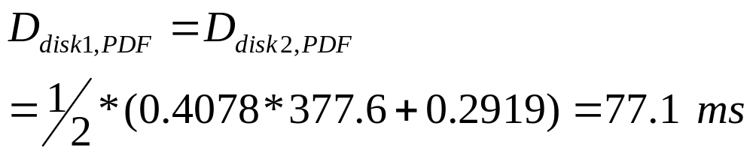
Building a Performance Model:
Computing Service Demands
Computed values for I/O
R² > 0,95 indicates adequate accuracy
From the case study specification, PDF Files are stored on disks 1 and 2 evenly balanced
Computation of Service Demand

Slide 23
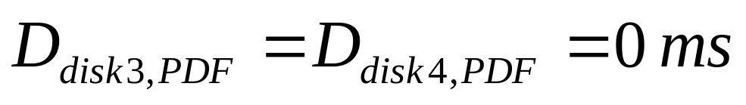
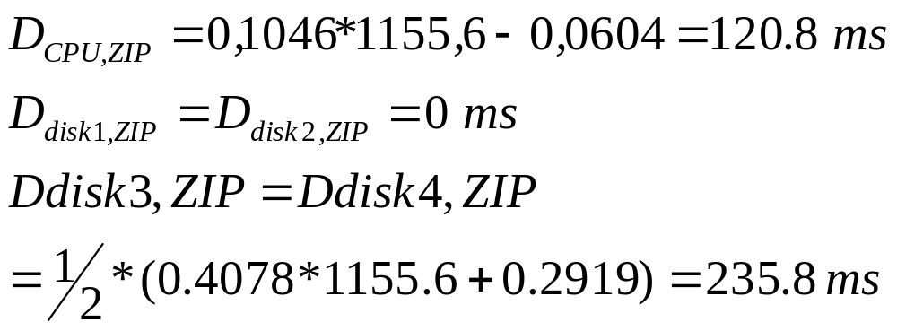
Building a Performance Model:
Computing Service Demands
Since no PDF files are stored on disk3 and disk4:
The results for ZIP files are:

Slide 24

Using the Model
The table gives a summary of all important data required by the closed QN model
Now the Excel spreadsheet „ClosedQN-chap6.xls“ can be used to solve the model
Resource | Class Service Demands
 | PDF | ZIP
CPU | 39.4 | 120.8
Disk1 | 77.1 | 0
Disk2 | 77.1 | 0
Disk3 | 0 | 235.8
Disk4 | 0 | 235.8

Slide 25
Using the Model
Now there is the idea of a balanced I/O configuration
PDF and ZIP files are stored evenly distributed across all four disks
Resource | Class Balanced Service Demands
 | PDF | ZIP
CPU | 39,4 | 120,8
Disk1 | 38,6 | 117,9
Disk2 | 38,6 | 117,9
Disk3 | 38,6 | 117,9
Disk4 | 38,6 | 117,9

Slide 26
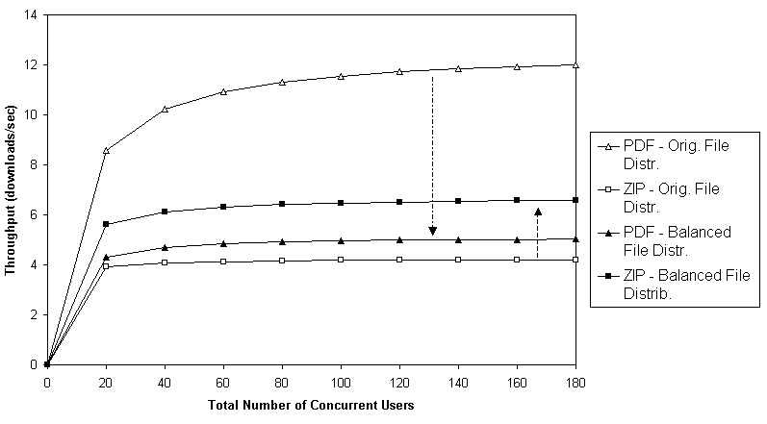
Using the Model: The Results
After 20 users the throughput saturates

Slide 27
Using the Model: The Results
Maximum Throughput:
  PDF 12 files/sec vs. 5 files/sec balanced
  ZIP 4.2 files/sec vs. 6.6 files/sec balanced

Slide 28
Using the Model: The Results
Throughput of ZIP files increases and throughput of PDF files is reduced as the configuration is changed to ”balanced“
Total throughput measured in files/sec is reduced by 28%
12 + 4.2 = 16.2 files/sec vs. 5 + 6.6 = 11.6 files/sec
Total throughput measured in bandwidth (kB/sec) increases by 1.4%
12 * 377.6 + 4.2 * 1156.6 = 9385.7 kB/sec
5 * 377.6 + 6.6 * 1156.6 = 9514.9 kB/sec

Slide 29
Using the Model: The Results
SLA
The SLAs on download times for PDF and ZIP files are 7 sec and 20 sec
  Chosen, because ZIP files are roughly three times larger
After about 20 users the throughput saturates (see page 26)
  Therefore the download times increase linearly with the # of concurrent users

Slide 30
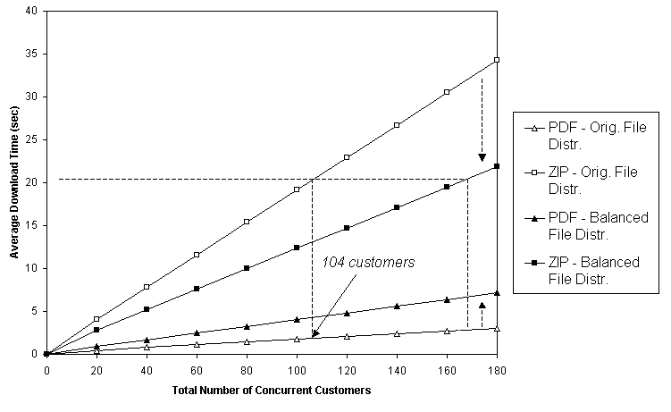
Using the Model: The Results (original)
For 104 users the download time for ZIP files hits its SLA
Download time for PDF is well below the 7sec SLA

Slide 31
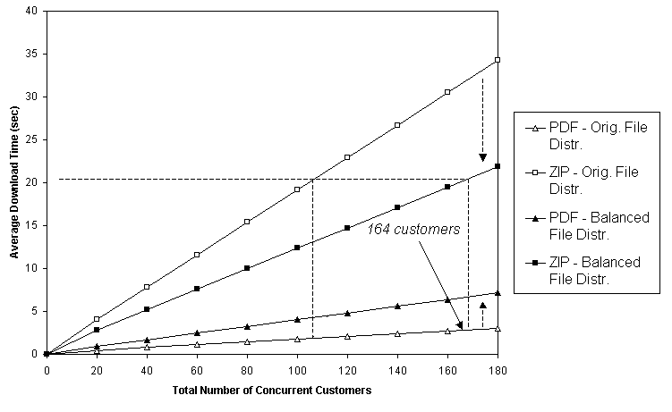
Using the Model: The Results (balanced)
For 164 users the download time for ZIP files hits its SLA
Download time for PDF is still below the 7sec SLA

Slide 32
Using the Model: The Results
SLA
Original model
104 concurrent users supported
ZIP files hit the 20sec SLA
PDF download time well below its 7sec SLA
Balanced model
164 concurrent users supported
ZIP files hit the 20sec SLA
PDF download time still below its 7sec SLA
Balanced configuration supports 58% more customers

Slide 33
Security
Security change performance
The CPU is encrypting/decrypting the file
No extra work for the disc
Notes:
Sicherheitsanforderung des Managment können erfüllt werden. Die Performance des Systems wird dadurch verändert. Verschlüsselung kostet CPU Zeit und wird in diesem Kapitel untersucht, bevor eine Verschlüsselung implentiert wird.

Slide 34
Transport Layer Security
TLS is application-independent
  Authentication
  Decrypting/encrypting file
  Hybrid proceeding
Handshake
  Public Key System (complex calculation -> long CPU demand)
File transfer
  symmetric Key (shorter CPU demand)
Notes:
TLS ist ein Hybrides Verfahren. Beim Handshake kommt ein Publik Key Verfahren zum Einsatz. Dies ist sehr Rechenintensiv. Der Client und Server bestimmen dabei einen symmetrischen Schlüssel, der bei der Verschlüsselung der Daten eingesetzt wird. Mit dem symmetrischen Verfahren können die Daten schneller Bearbeitet werden, trozdem kostet dies immernoch CPU Zeit.
Handshake, der Client soll sich Authentifiziern:
ClientHello --→
←- ServerHallo
Certifikat --→
Server verschlüsselt den symmetrischen Schlüssel mit dem PublicKey im Certifikat
←- Verschlüsselter Schlüssel ( PublicKey mit Schlüssel für symmetrische Verchlüsselung)
Decryption
Beide Seiten haben nun den selben symmetrischen Schlüssel.
Achtung! Verfahren wurde stark vereinfacht und entspricht nicht dem tatsächlichen Packetaustausch.

Slide 35
Cryptography
Encryption
  Secrecy
    Symmetric and Asymmetric System
  Authenthication (who is user ?)
Digital Signature
  Authenthication
Notes:
Secrecy = Geheimhaltung

Slide 36
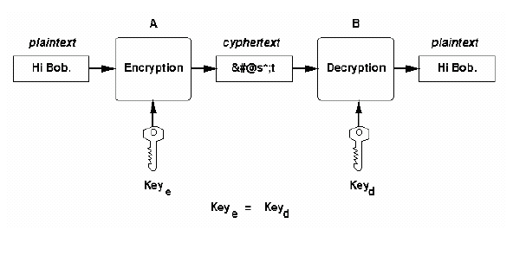
Symmetric System

Slide 37
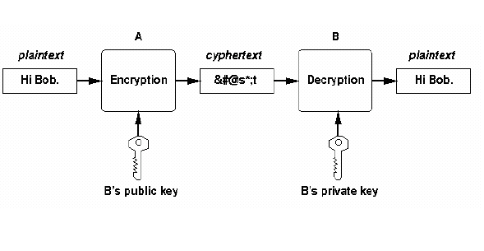
Asymmetric System (Public Key)
Notes:
Lange Rechenzeit

Slide 38
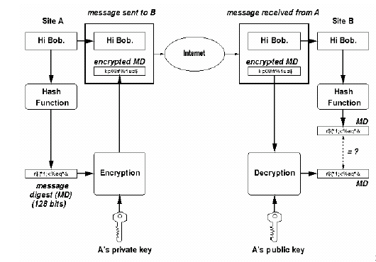
Digital Signature
Notes:
Das ganze Funktioniert wie folgt:
A berechnet aus der Nachricht einen Hashwert, dieser wird mit dem privaten Schlüßel verschlüßelt!
A sendet die Nachricht (UNVERSCHLÜSSELT) und den verschlüsselten Hash-Wert zu B. B kann nun überprüfen ob die Nachricht von A kommt, indem der Hashwert mit dem public Schlüßel entschlüßelt wird und dann dieser Wert mit dem Hashwert aus der Nachricht verglichen wird!

Slide 39
CPU Time
Factors to increase the CPU Time
  Handshake once per file
    Key Exchange with an asymmetric system
  Encryption before the file is downloaded
    Symmetric System for encryption
  Security level
Extra time will be added to the normal CPU time
Notes:
Der Handshake nutzt bei der Erstellung des symmetrischen Schlüssel sehr intensiv die CPU, wird aber nur beim start der gesicherten Verbindung benötigt.
Die Daten werden verschlüsselt gesendet, hier ist die entscheidene die Größe der Datei, da pro KB CPU Zeit benötigt wird.
Eine höhere Sicherheit ( größere Schlüssellange + verbessertes PubliKey Verfahren) kostet mehr CPU Rechenzeit.

Slide 40
CPU Time (2)
CPU Time Required for Secure Download Options
For example : low security and pdf file
  The average document file for PDF is 377,6 KB.
  The addition CPU Time is 49,5 [msec] (=10,2 + 0,104 x 377,6 )
 | CPU Handshake Time per File [msec] | CPU Processing Time per KB [msec]
Low Security Medium Security High Security | 10,2 23,8 48,0 | 0,104 0,268 0,609
Notes:
Wird anhand zweier Excel Datei nochmal demonstriert.
Wie die Werte in der Tabelle bestimmt werden steht im Buch von Menasce und Almeida

Slide 41
Performance
Additional CPU Service Time depend from the security level and the file size
 | PDF | ZIP
Low Security Medium Security High Security | 49,5 125,0 278,0 | 130,4 333,5 751,8
Notes:
Zusätzliche Zeit = HandShakeZeit + FaktorDerSicherheit x DurchschnittsGrösse
z.b:
49,5 = 10,2 + 0,104 x 377,6
125,0 = 23,8 + 0,268 x 377,6

Slide 42
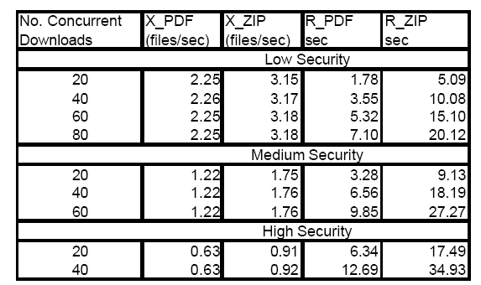
Throughputs and download time
Notes:
In dieser Tabelle ist X der Durcxhsatz (throughput) und R die Download Zeit abgebildet, sowohl für die PDF als auch für die Zip Dateien

Slide 43
Results: Security
Symmetric vs Asymmetric System
  The Symmetric System is fast
  The Asymmetric is slower and more secure
Kombination of both
  The Asymmetric is used as Session Key to enrypt the files with a Symmetric Key
Better Security System (longer Key) need more CPU Time

Slide 44
Experiment
Performance Engineering involves experiments with a existing system
  Designing different experiments, conducting them and analyse the results
Many factors have an affect to the Performance
  Sophistication of factors is possible
Combination raise the amount of experiments
Notes:
Sopistication = verfeinerung

Slide 45
Factors
increasing the performance of a web server
Factors are
  Number of Processors and the speed of the cpu
  Main Memory
48 possible combinations (4x3x3)
Factor | Levels
Processor Speed (GHz) Number of Processors Main Memeory (GB) | 2.0, 2.4, 2.8, 3.1 1, 2, 4, 8 1, 2, 4

Slide 46
Amount
The amount of possible experiments is to big
Elimination of unimportant factors
  Idea: if the factor is a linear size, we can omit all between the lowest ant the highest factor
  With this method we have after the elimination „only“ 2^{k} possible combinations
Notes:
Um alle Varianten durchzuprüfen müssten sehr viele Versuche gemacht werden. Faktoren die einen fast linearen Einfluss auf die Geschwindigkeit haben, werden nur mit zwei Werten gemessen. Dadurch erhalten wir eine reduktion der Varianten

Slide 47
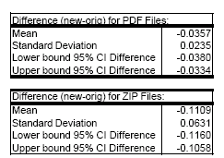
Confidence level
Comparison of two alternatives
  Measure the Results from the old and new System
  Calculate the difference of the Standard Deviation and the Confidence Interval
Results
Notes:
Es werden zwei verschiedene WebServer miteinader verglichen. Alte Konfiguration gegen neu. Das Confidenz level berechnen und prüfen ob die zwei Variationen innerhalb der 95% sind.
Vorghensweise:
Repräsentative Arbeitslast (workload) zur Spitzenlast messen. In unserem Fall: 100 Daten zur peaktime in einer Excel Datei
Getrennte die Download Zeit messen
Daten sortieren und die differenz zwischen alt und neu DownloadZeit berrechnen
95% Confidence level berrechnen
Wenn die Null im Intervall ist, besteht kein Unterschied
Falls nicht ist ein Server besser
In unserem Rechenbeispiel ist der neue Server besser als der alte

Slide 48
Result : Experiment
Reducing the number of experiments
  Only possible if the factor is linear
Measure the relevant Data (Throughputs and download time)
If the Standard Deviation is in the Confidence Interval, the new System is not faster !

Slide 49
References
Textbook:
  Performance by Design – Computer Capacity Planning by Example,
  D. Menascé, V. Almeida, L. Dowdy; ISBN 0-13-090673-5
Internet Links:
  http://cs.gmu.edu/~menasce/cs672/slides/cs672-CaseStudy-II-WebServer.pdf click
  http://www.cs.gmu.edu/~menasce/perfbyd/files/chapter6.ZIP click
  http://www.cacr.math.uwaterloo.ca/hac/

